Slide 1
First Silver Dots
10% mass loading of silver in 90% WD-40
1-3 Micron average diameter silver particles
Printed with ~12 watts of peak input power (manually controlled)

Slide 2
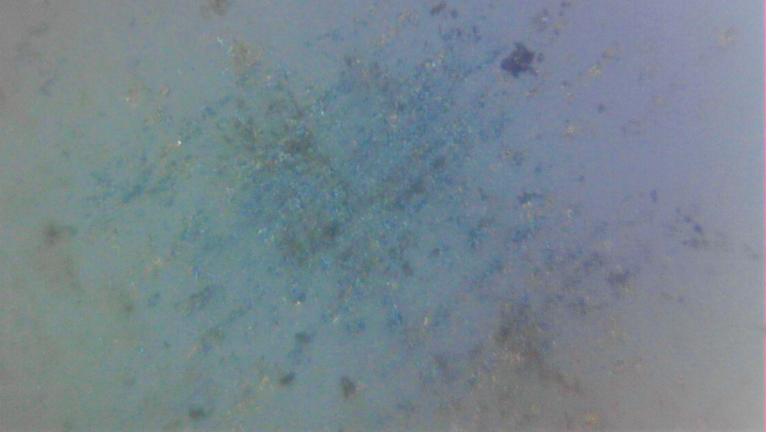
0.75mm
< 10 micron thick Silver deposit
0.75mm
Al2O3 Substrate
Single pulse deposit

Slide 3
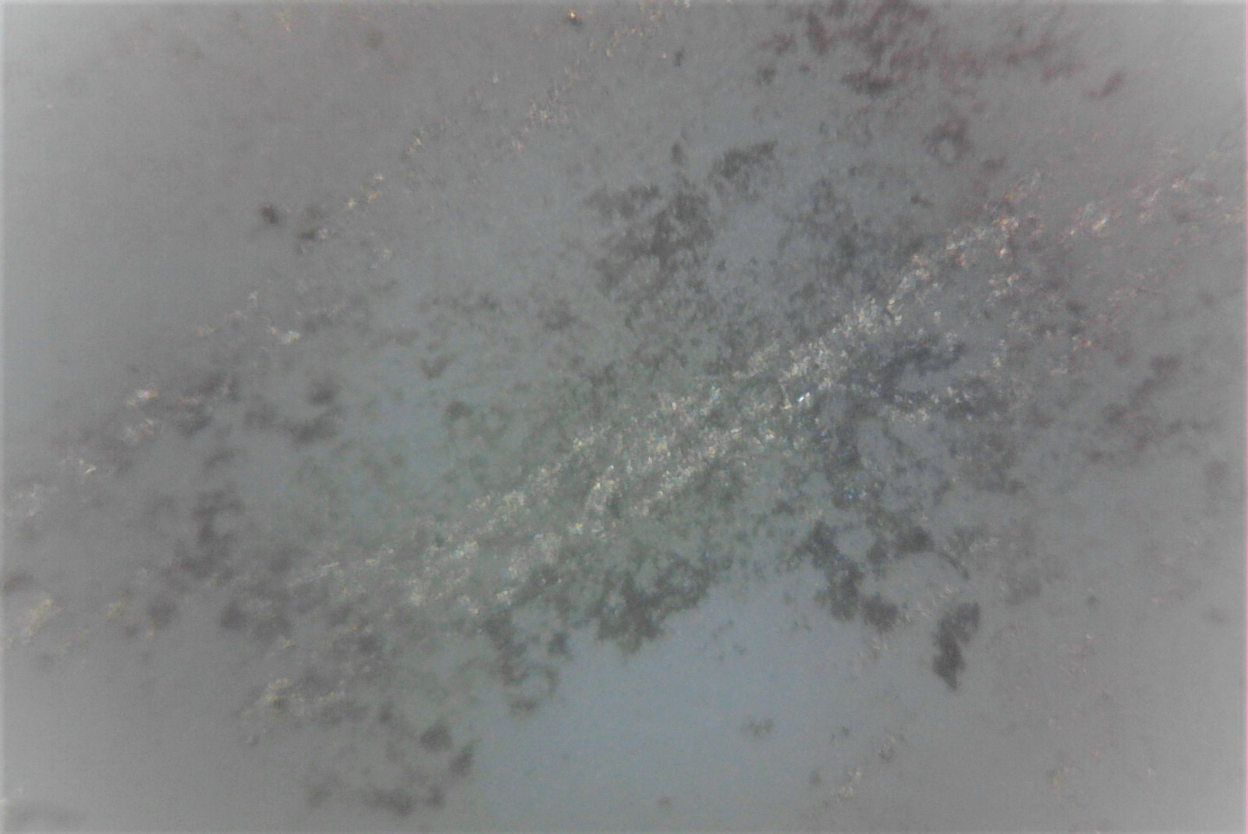
1.5mm
Steel needle scratch zone
< 10 micron thick Silver deposit
1.0mm
Al2O3 Substrate
Two pulse deposit
Print Direction

